Slide 1




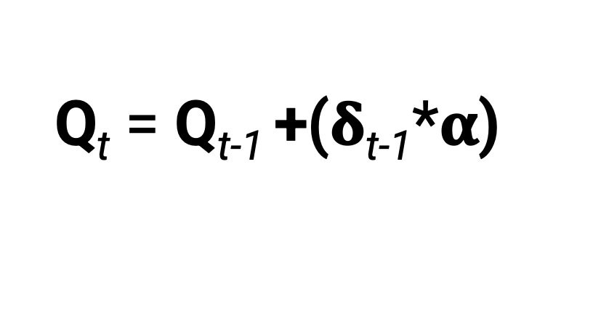
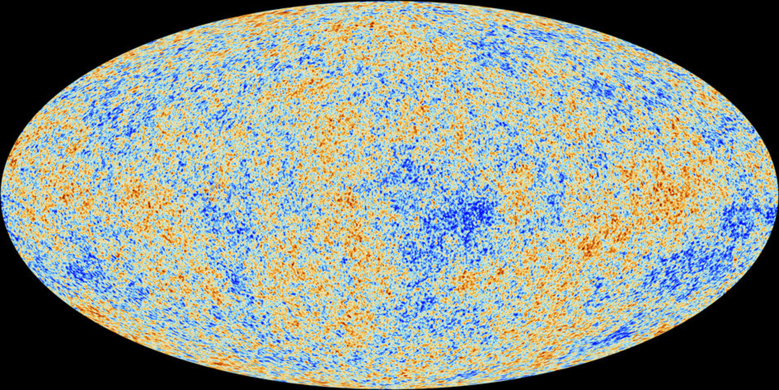
Reinforcement learning
Javier Ortiz-Tudela
LISCO Lab (Goethe Universität, Frankfurt Am Main)
Notes:
1

Slide 2
Why computational models? My personally-biased take.
Three key reasons:
They require explicit and precise definitions.
They allow us to think (speak) in computational terms.
Formal comparison of different models -> Critical for (good) theory building!
2
Notes:
2

Slide 3
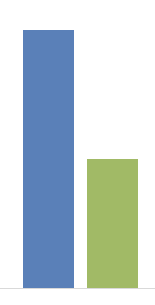
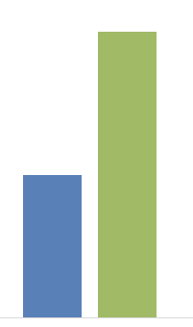
Why computational models? My personally-biased take.
Long term (episodic) effects of transient shifts of attention during encoding
Beneficial or detrimental?
3
Notes:
3

Slide 4
Why computational models? My personally-biased take.
Long term (episodic) effects of transient shifts of attention during encoding
Experimental manipulations
Stroop congruity
Expectation violation
Dual tasks
Spatial cues
Cognitive constructs
Cognitive control
Prediction error
Selective attention
Attentional orienting
Shared mechanism
Upregulation of encoding mechanisms
4
Notes:
4

Slide 5
Why computational models? My personally-biased take.
Long term (episodic) effects of transient shifts of attention during encoding
Experimental manipulations
Stroop congruity
Expectation violation
Dual tasks
Spatial cues
Cognitive constructs
Cognitive control
Prediction error
Selective attention
Attentional orienting
5
Notes:
5

Slide 6

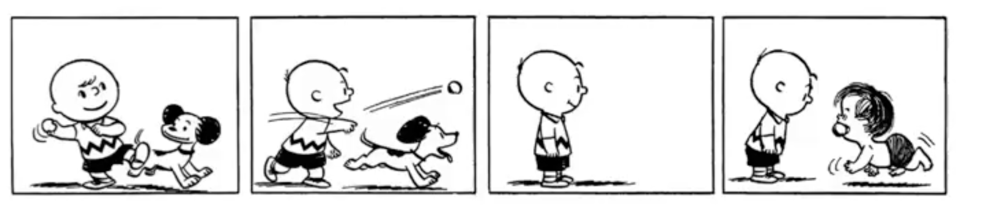
Why computational models? My personally-biased take.
Prediction error
“Unexpected events are remembered better than expected ones”
Notes:
6
6
6
6

Slide 7
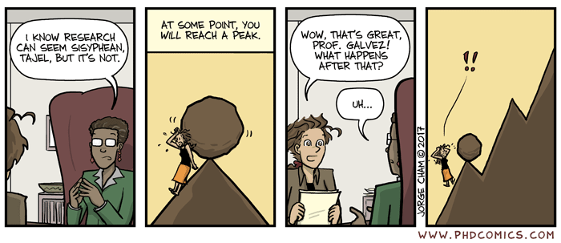
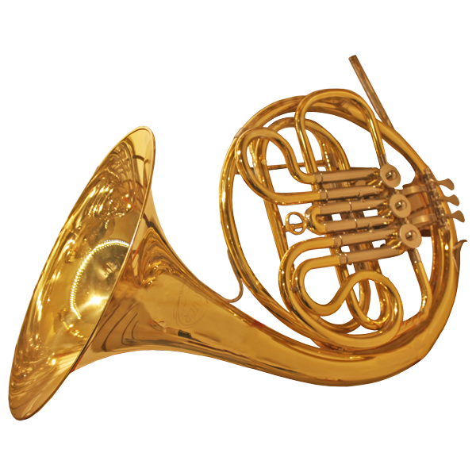
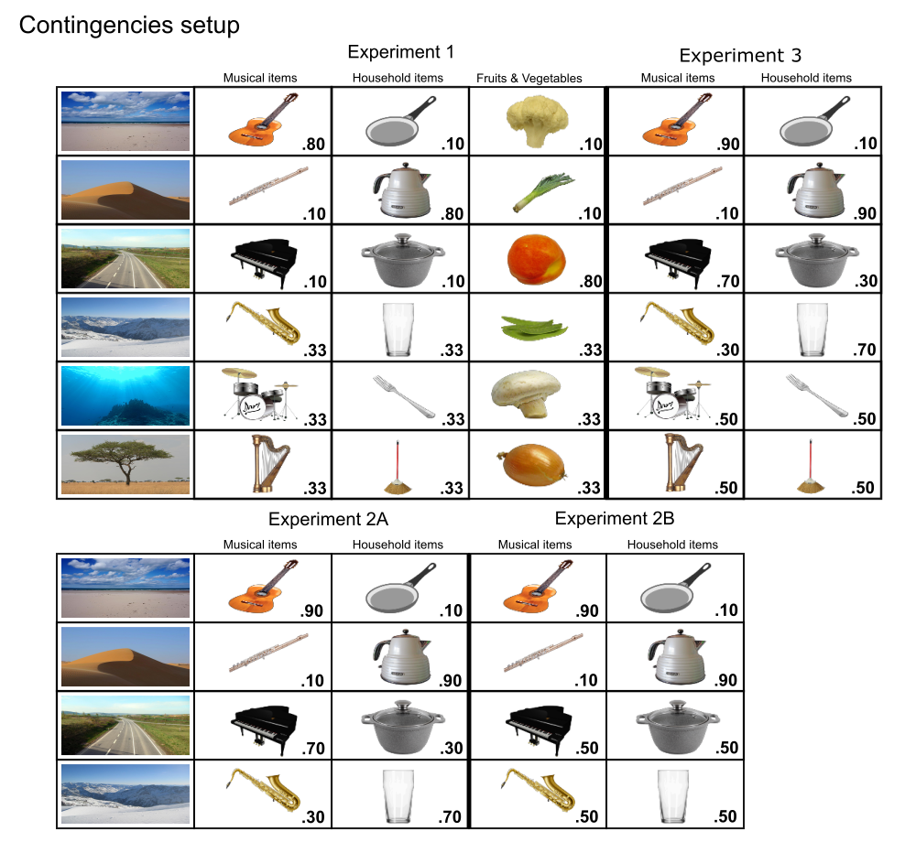
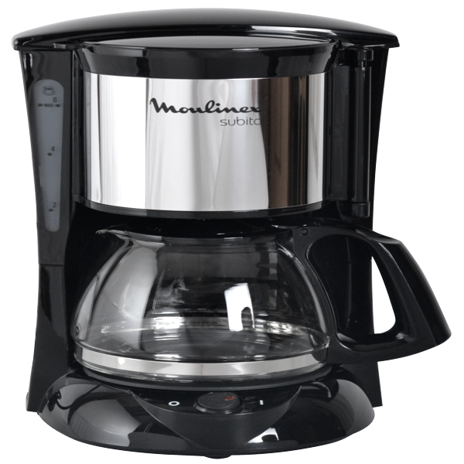
Why computational models? My personally-biased take.
Prediction error
“Unexpected events are remembered better than expected ones”
Supervisor be like:
Musical instrument
“Let’s build a computational model for your task!”
frequent
Household object
infrequent
Notes:
7
7
7
7

Slide 8
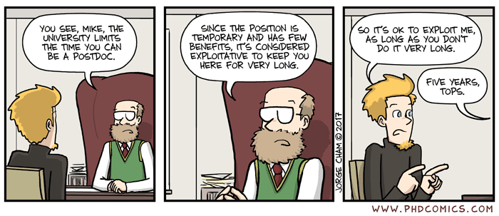
Why computational models? My personally-biased take.
Prediction error
“Unexpected events are remembered better than expected ones”
Supervisor be like:
“Let’s build a computational model for your task!”
What is “(un)expected”?
What do you mean with “remembered”?
How much “better”?
Notes:
8
8
8
8

Slide 9
Why computational models? My personally-biased take.
Prediction error
“Unexpected events are remembered better than expected ones”
Supervisor be like:
“Let’s build a computational model for your task!”
What is “(un)expected”?
What do you mean with “remembered”?
How much “better”?
Notes:
9
9
9
9

Slide 10
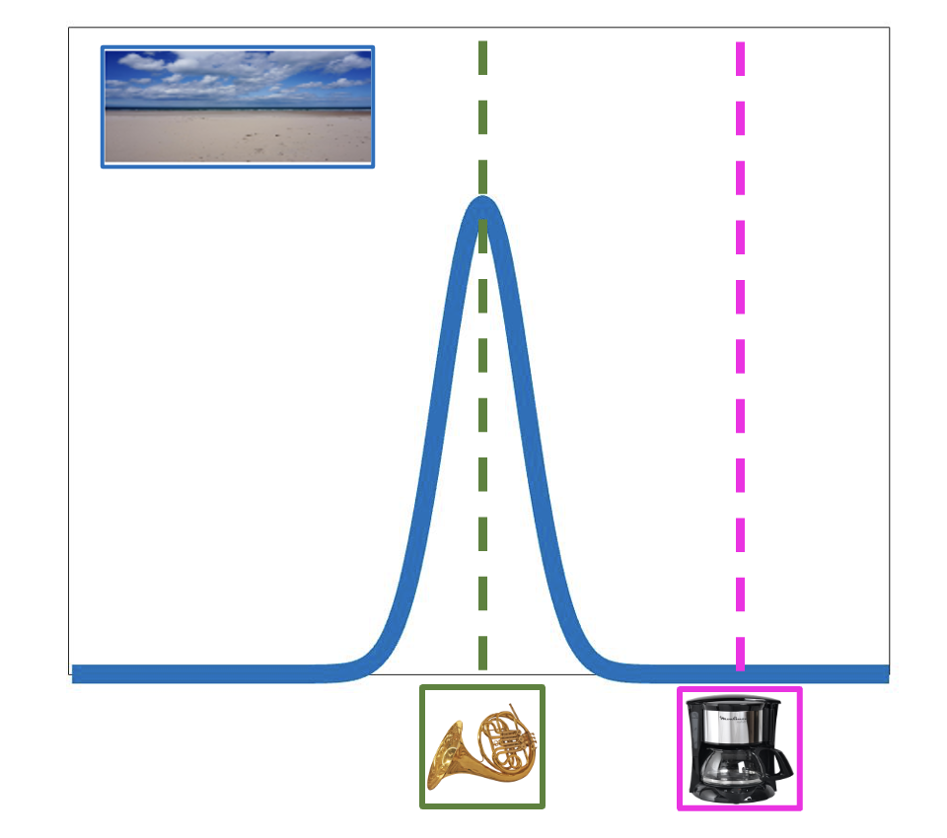
Why computational models? My personally-biased take.
What is “(un)expected”?
What do you mean with “remembered”?
How much “better”?
Prediction error
“Unexpected events are remembered better than expected ones”
Musical instrument
“Expected events”
=
“Encountering objects from the most likely category”
=
Expectation level of 70%
&
“Unexpected events”
=
“Encountering objects from the least likely category”
=
Expectation level of 30%
70%
Household object
30%
Notes:
10
10
10
10

Slide 11

Why computational models? My personally-biased take.
What is “(un)expected”?
What do you mean with “remembered”?
How much “better”?
Prediction error
“Unexpected events are remembered better than expected ones”
Musical instrument
70%
“Expectation”
=
“Established contingency”
Household object
30%
Notes:
11
11
11
11

Slide 12
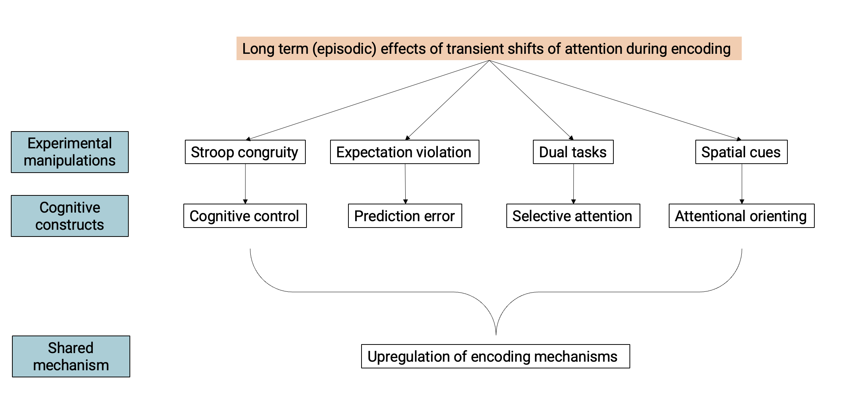
Why computational models? My personally-biased take.
What is “established contingency” in a Stroop task?
How do you define “expectancy” in a dual task setup?
Is scene-to-object contingency the same as cue predictivity?
?
12
Notes:
12

Slide 13
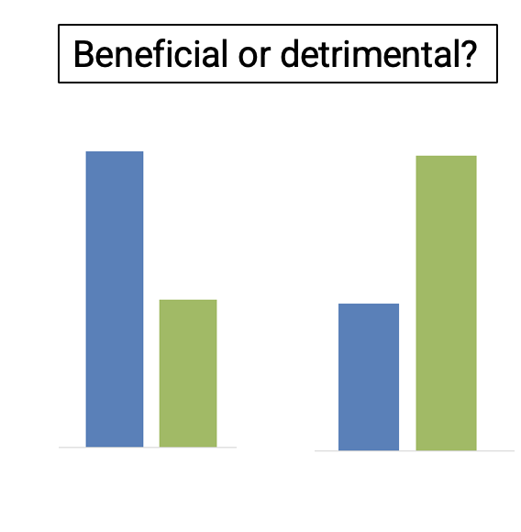
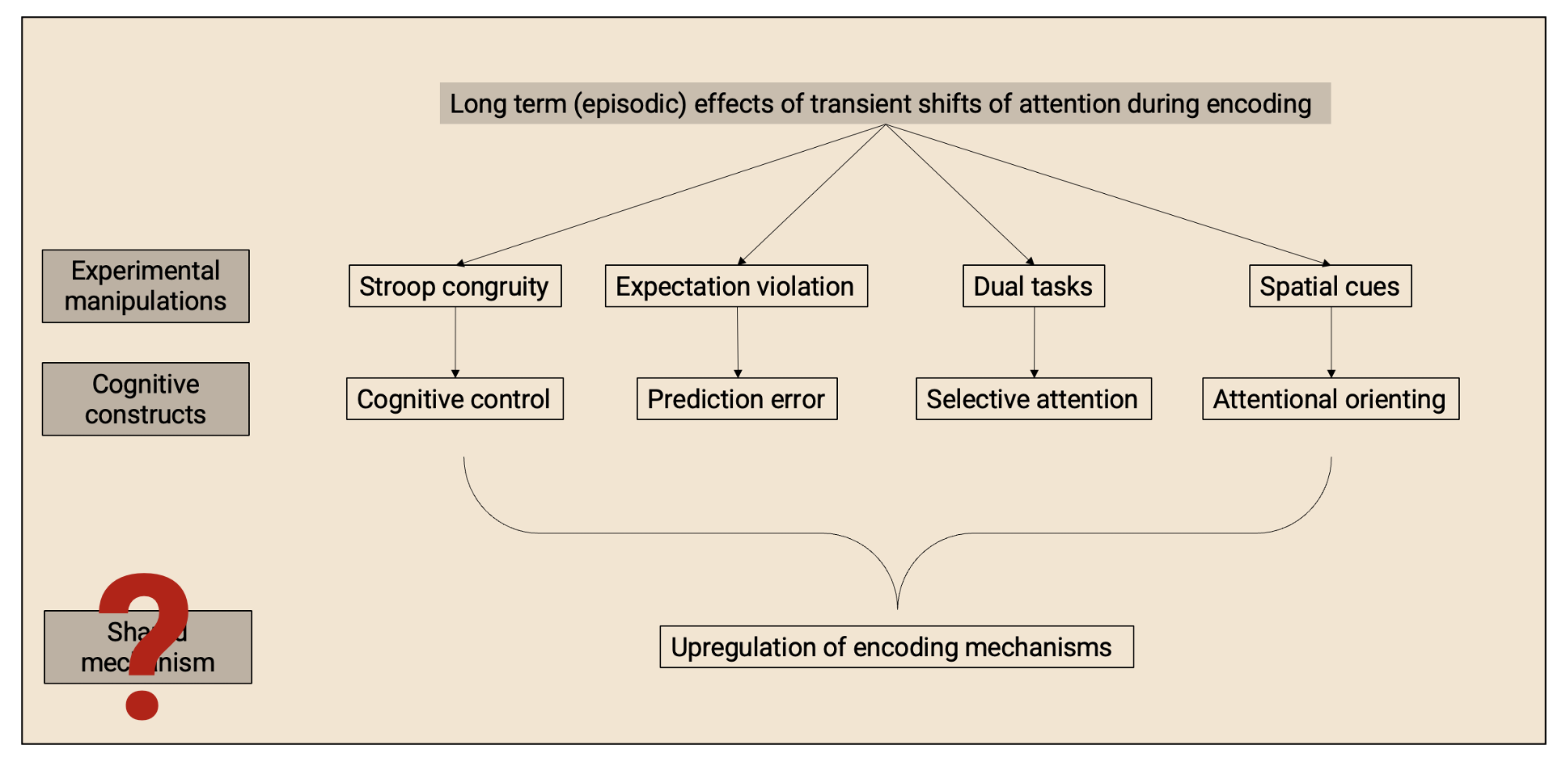
Why computational models? My personally-biased take.
Three key reasons:
They require explicit and precise definitions.
They allow us to think (speak) in computational terms.
Formal comparison of different models -> Critical for (good) theory building!
13
Notes:
13

Slide 14
Why computational models? My personally-biased take.
Three key reasons:
They require explicit and precise definitions.
They allow us to think (speak) in computational terms.
Formal comparison of different models -> Critical for (good) theory building!
Questions?
14
Notes:
14

Slide 15


Reinforcement learning.
Scary formula!
Time to Zoom out
You’re a scientist!
15
Notes:
15

Slide 16
Reinforcement learning.
How do people learn to make decisions?
RL -> Decisions are made based on the perceived value of each option
16
Notes:
16

Slide 17
Reinforcement learning. A toy model
How do people learn to make decisions?
RL -> Decisions are made based on the perceived value of each option
Q_{t} = Q_{t-1} + 𝛅_{t-1}
17
Notes:
17

Slide 18
Reinforcement learning. A toy model
The value you assign to a stimulus at a point in time is a combination of the value you had for that stimulus at a previous point in time and of any novel information when you last saw it.
Explicit unpacking of the variables involved
18
Notes:
18

Slide 19
Reinforcement learning. A toy model
The value of a stimulus_{t} is a combination of the value of that stimulus_{t-1} and of any novel information_{t-1}.
19
Notes:
19

Slide 20
Reinforcement learning. A toy model
Q_{t} is a combination of Q_{t-1} and of any novel information_{t-1}.
20
Notes:
20

Slide 21
Reinforcement learning. A toy model
Q_{t} is a combination of the Q_{t-1} and 𝛅_{t-1}.
21
Notes:
21

Slide 22
Reinforcement learning. A toy model
Q_{t} is a combination of the Q_{t-1} + 𝛅_{t-1}.
Warning!
Here’s where they force you to operationalize your (vague) assumptions!
22
Notes:
22

Slide 23
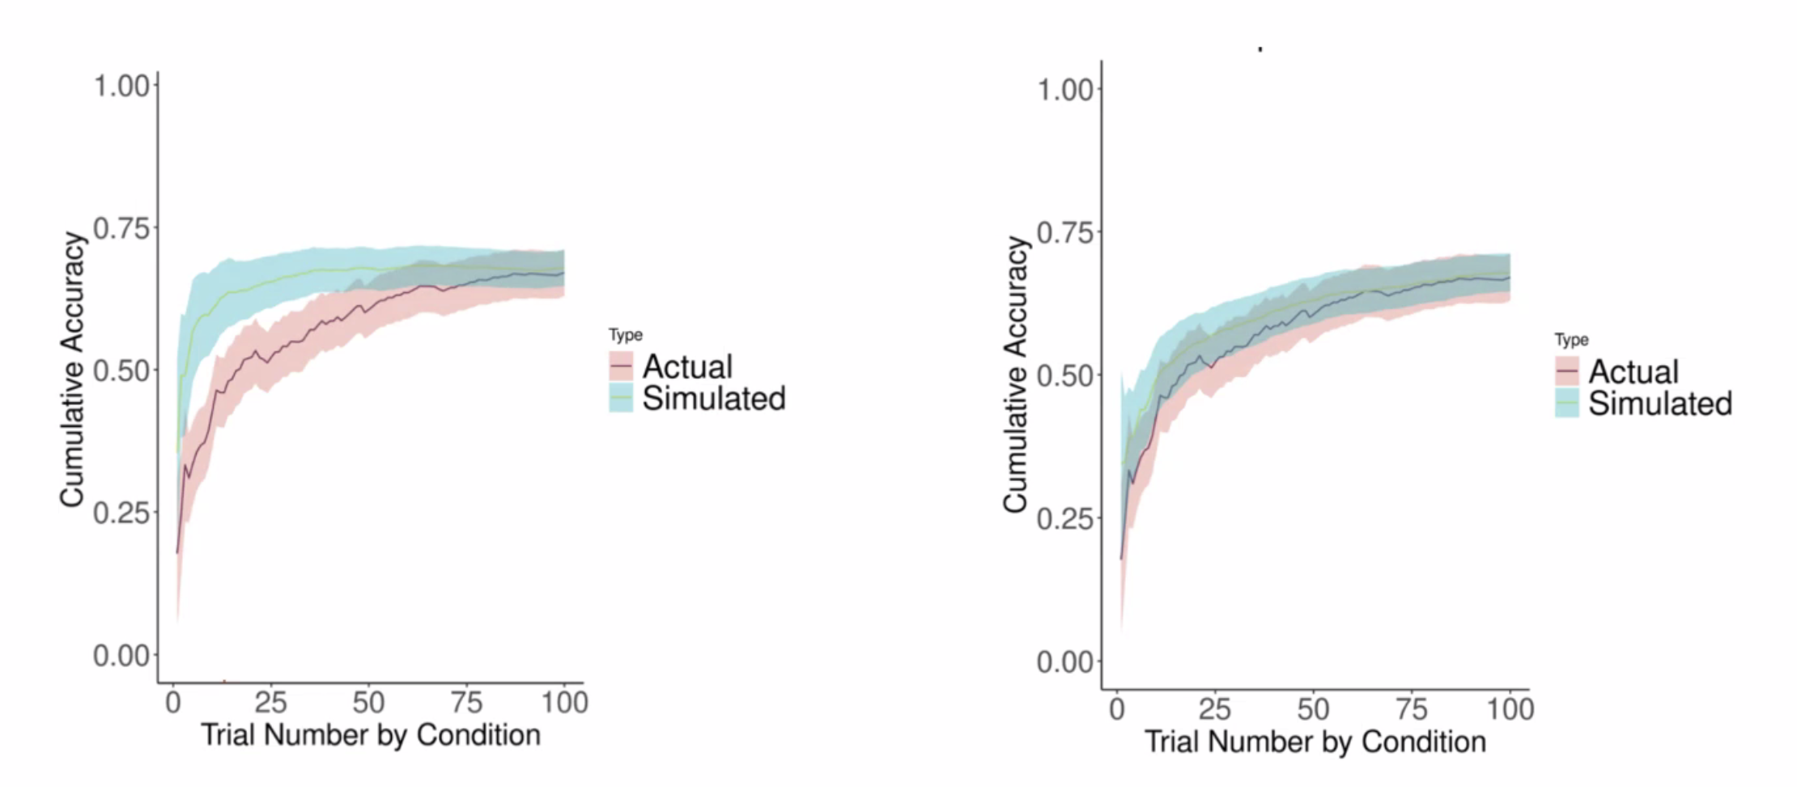
Reinforcement learning. A toy model
Now we have a formula that mathematically describes how we believe learning of the value of a stimulus takes place over time.
Q_{t} = Q_{t-1} + 𝛅_{t-1}
23
Notes:
23

Slide 24
Reinforcement learning. A toy model
Have you considered learning can vary over time?
Now we have a formula that mathematically describes how we believe learning of the value of a stimulus takes place over time.
We can add new parameters
Q_{t} = Q_{t-1} + 𝛅_{t-1}
𝛂: learning rate
24
Notes:
24

Slide 25
Reinforcement learning. A toy model
How does the learning rate relate to the other params?
Now we have a formula that mathematically describes how we believe learning of the value of a stimulus takes place over time.
We can add new parameters
Q_{t} = Q_{t-1} + 𝛅_{t-1}
𝛂: learning rate
The learning rate modulates how much the new information is used to update the value
25
Notes:
25

Slide 26
Reinforcement learning. Rescorla-Wagner model
How does the learning rate relate to the other params?
Now we have a formula that mathematically describes how we believe learning of the value of a stimulus takes place over time.
We can add new parameters
Q_{t} = Q_{t-1} + 𝛅_{t-1}
𝛂: learning rate
The learning rate modulates how much the new information is used to update the value
Q_{t} = Q_{t-1} + (𝛅_{t-1}*𝛂)
26
Notes:
26

Slide 27
Reinforcement learning. Rescorla-Wagner model
Q_{t} = Q_{t-1} + 𝛅_{t-1}
Q_{t} = Q_{t-1} + (𝛅_{t-1}*𝛂)
NOTE: Dummy illustration: see Francesco’s slides for actual models
27
Notes:
27

Slide 28
Reinforcement learning. Rescorla-Wagner model
Our formula accurately* describes how learning takes place over time.
Now what?
Q_{t} = Q_{t-1} + (𝛅_{t-1}*𝛂)
We know that …
value is updated based on the novel information that we encounter.
information intake decreases over time as a function of alpha.
With the current model we can ask new research questions such as …
Does learning rate (alpha) differ for different people/populations?
Can learning rate be increased with some external manipulation?
Is there a brain region that responds to the presence novel information?
Is the amount of novel information at encoding related to long-term retention?
But we can also think of new models by adding new parameters:
Does WM capacity influence learning?
Does conflict affect value estimations?
Are different types of information used in the same way?
*more accurately than other models as “all models are wrong, but some are useful” (Box, 1978)
28
Notes:
28

Slide 29
Reinforcement learning. Rescorla-Wagner model
Our formula accurately* describes how learning takes place over time.
Now what?
Q_{t} = Q_{t-1} + (𝛅_{t-1}*𝛂)
We know that …
value is updated based on the novel information that we encounter.
information intake decreases over time as a function of alpha.
With the current model we can ask new research questions such as …
Does learning rate (alpha) differ for different people/populations?
Can learning rate be increased with some external manipulation?
Is there a brain region that responds to the presence novel information?
Is the amount of novel information at encoding related to long-term retention?
But we can also think of new models by adding new parameters:
Does WM capacity influence learning?
Does conflict affect value estimations?
Are different types of information used in the same way?
Now to the hands-on part!
*more accurately than other models as “all models are wrong, but some are useful” (Box, 1978)
29
Notes:
29

